Slide 1
Close Reading
How to Comprehend a Text

Slide 2
Five Strategies to Help You Understand the Text Better
Number the Paragraphs
Chunk the Text
Underline and Circle….with a Purpose
Left Margin: What is the Author Saying?
Right Margin: Dig Deeper into the Text.

Slide 3
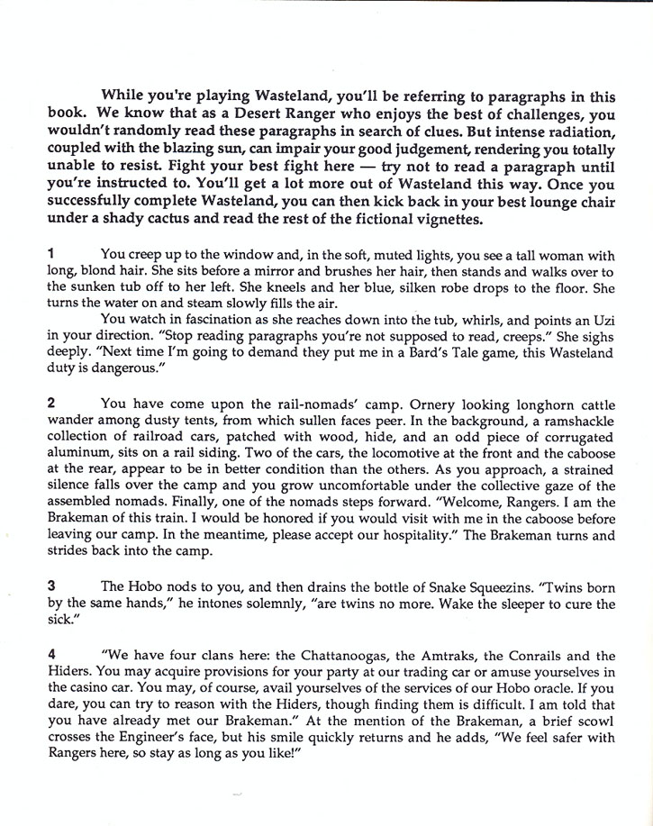
Step One: Number the Paragraphs in the Text
The Common Core asks students to be able to cite and refer to the text. One simple way to do this is by numbering each paragraph, section or stanza in the left hand margin.

Slide 4
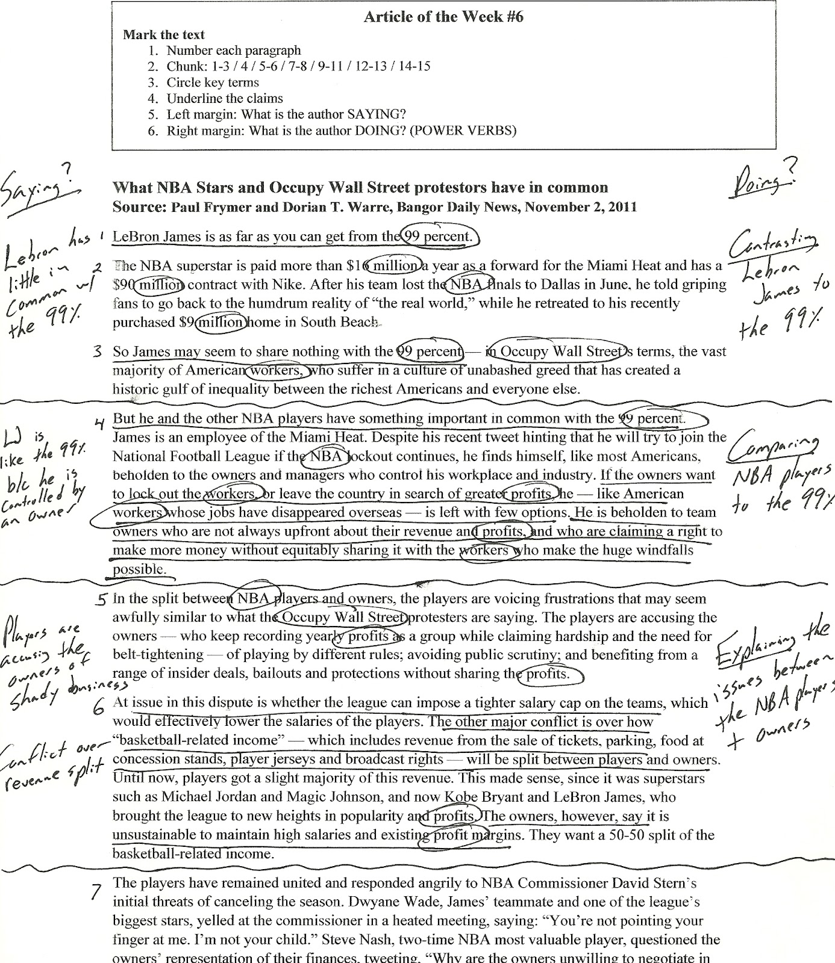
Step Two: Chunk the Text
Draw a horizontal line between paragraphs to divide the page into smaller sections. Group paragraphs according to their content. Paragraphs that are similar should be grouped together.

Slide 5
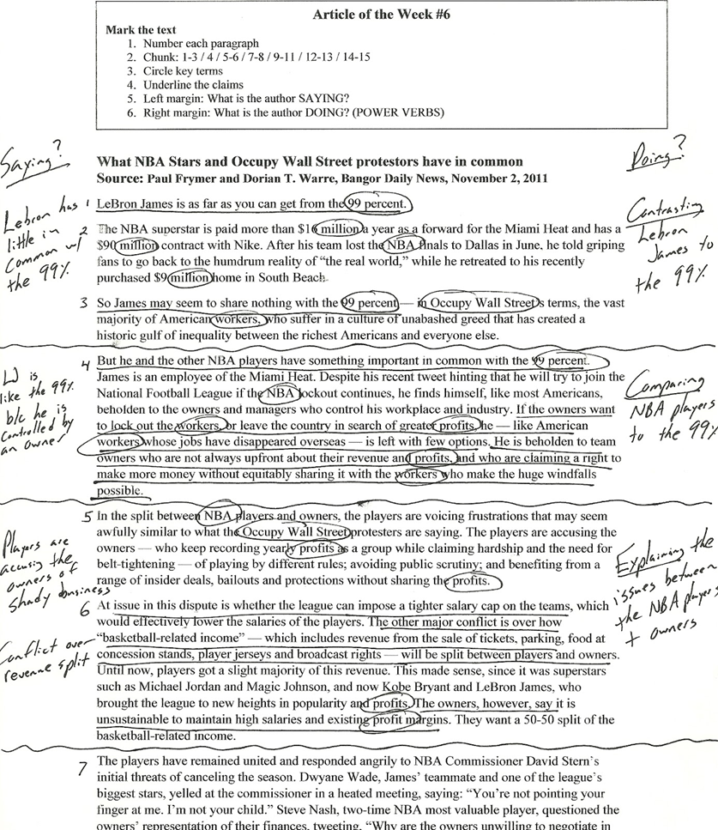
Step Three: Underline and Circle….with a Purpose
Underline claims or belief statements that the author is making. Circle key terms; words that are defined or repeated over in the text.

Slide 6
Step Four: Left Margin, What is the Author saying?
Summarize each chunk in 10 words or less.

Slide 7
Step Five: Right Margin, Dig Deeper into the Text.
For each chunk that you created in the text:
Use a power verb to describe what the author is DOING. (For example: Describing, illustrating, arguing, etc..)

